Slide 1
ISOMETRIC
RPG

Slide 2
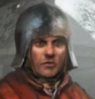
OUR GROUP
Mehmet Yiğit Aktaş
Ipek Özgenç
Ipek Öğretmenoğluı

Slide 3
Table of contents
01
03
02
04
Game View & Environment
NPCs
Our Character
Development Plan

Slide 4
01
Game View & Environment
‘‘isometric’’

Slide 5
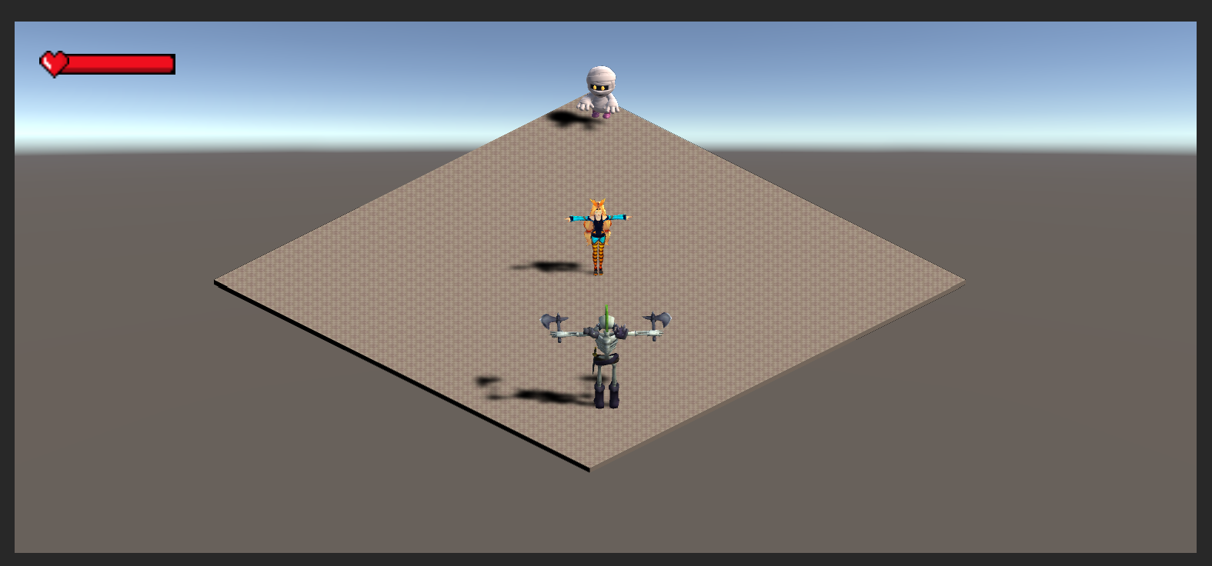
Game View
Isometric Game Experience
Camera Rotation: 30 - 45 - 0
2.5D Game:
Characters -> 3D
Environment -> Partially 2D

Slide 6
02
Our Character

Slide 7

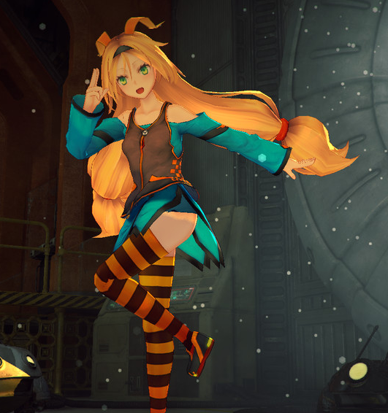
Our Character
Placeholder
Walking/Jumping
  Walking -> w, a, s, d
  Jumping -> space bar
  Animations
Health Bar + Take Damage
Unity-chan

Slide 8
03
NPCs
enemy, companion, quest giver…

Slide 9
NPC Types
1. Enemy
2. Companion

Slide 10
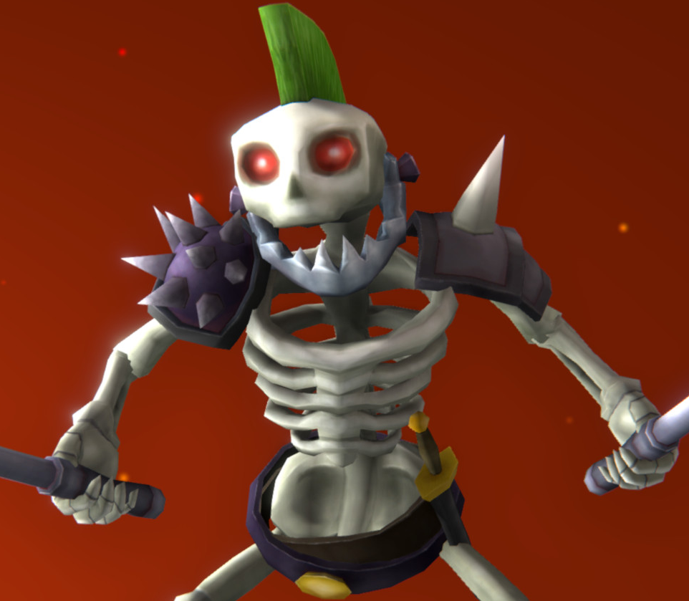
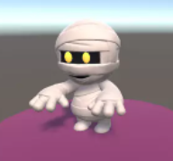
NPCs
Skeleton
Friendly Mummy
Enemy
Detect Character
Run Towards Character
Deal Damage
Companion
Detect Character
Run Towards Character
Follows Arround
Placeholder

Slide 11
04
Development Plan

Slide 12
Development Plan
Dungeons
Figthing System
Quest giver NPC
Will add multiple dungeons that our character will enter to accomplish a serios of missions. ( Level Tower )
Includes little enemies, level bosses
Satisfies the fighting component
With magic or sword
Hit detection and animations for both
Kill or be killed
Boss Drops (Potion, Weapons, etc)
Inventory System ( Potions, etc. )

Slide 13

Thank you for listening!

